Slide 1
Summary of Data and Trends for Donor Advised Fund, Proceeding, and Relationship Disclosure
Fair Political Practices Commission, Executive Researcher Cole Smith

Slide 2
Behested Payment Reporting Requirements
The Political Reform Act (PRA) requires an elected state official, elected local official, or Public Utilities Commission (PUC) member to disclose certain information about payments made for a charitable, legislative, or governmental purpose when the official is involved in making the request for payment.

Slide 3
The Purpose of Behested Payment Reporting
The Fair Political Practices Commission Legal Division has interpreted the purpose of reporting behested payments in advice letters.

Slide 4
A brief recent history of Commission action on Behested Payment Reporting
At the May 11, 2021, Law & Policy Committee meeting, the Commission discussed several behested payment reporting issues.
At the October 11, 2021, Commission meeting, the Commission adopted and repealed regulations to address the identified areas.
At the September 21, 2023, Commission meeting, the Commission requested an update on how these regulations have been working and what information the new reporting requirements have yielded.

Slide 5
Four Areas of Concern
Relationships and Proceedings
Estimates
Clarification on Charitable Organization Fundraising Solicitations
Donor Advised Funds

Slide 6
New Regulations Adopted to Address Areas of Concern
Regulations:
  18424 concerning Relationships and Proceeding Disclosure
  18424.1 concerning Good Faith Estimates
  18424.2 concerning Charitable Organization Fundraising solicitations (repealed 18215.3)
  and 18424.3 concerning payments from Donor Advised Funds

Slide 7
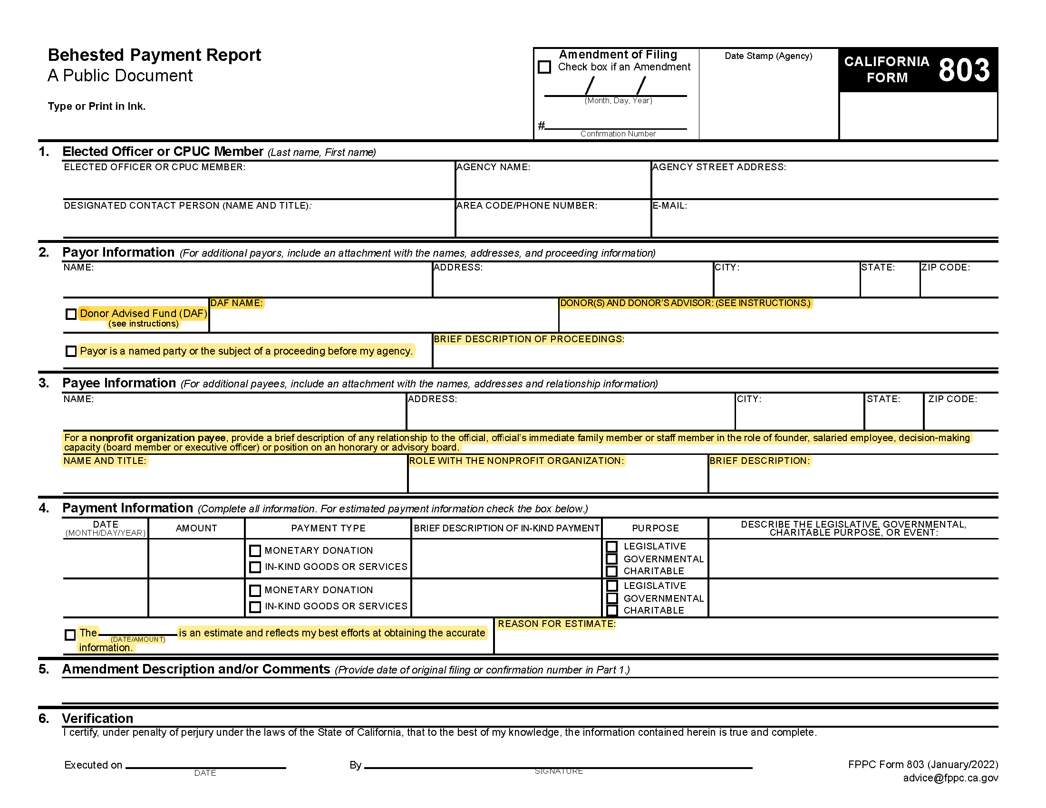
Updated version of
Form 803
The Commission approved a new Form 803 that reflected the new reporting requirements beginning February 17, 2022.
The highlighted fields are those that were added to capture the new reporting of additional information as a result of the new regulations.

Slide 8
Complaints and Cases –
February 17, 2022 – September 30, 2023
The Commission received 28 complaints related to Form 803s, 15 of which resulted in the opening of 10 Enforcement cases.
None of the complaints or cases reviewed alleged violations of the new regulations.

Slide 9
Finding #1:
Greater transparency of relationships between officials, donors, and recipients and potential influence on official action.
  Approximately 25% of the state and local submissions examined included information pursuant to one or more of the new disclosure categories.

Slide 10
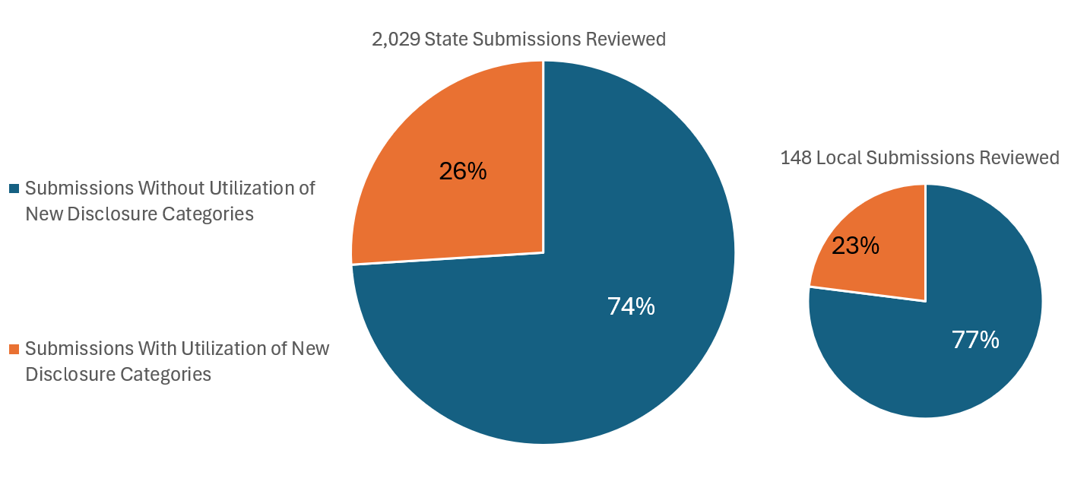

Slide 11
Finding #2:
Of the three new disclosure categories, public officials more often disclosed a relationship with the recipient of a behested payment than a proceeding impacting the source of a behested payment or a donor advised fund as a source of a payment.

Slide 12
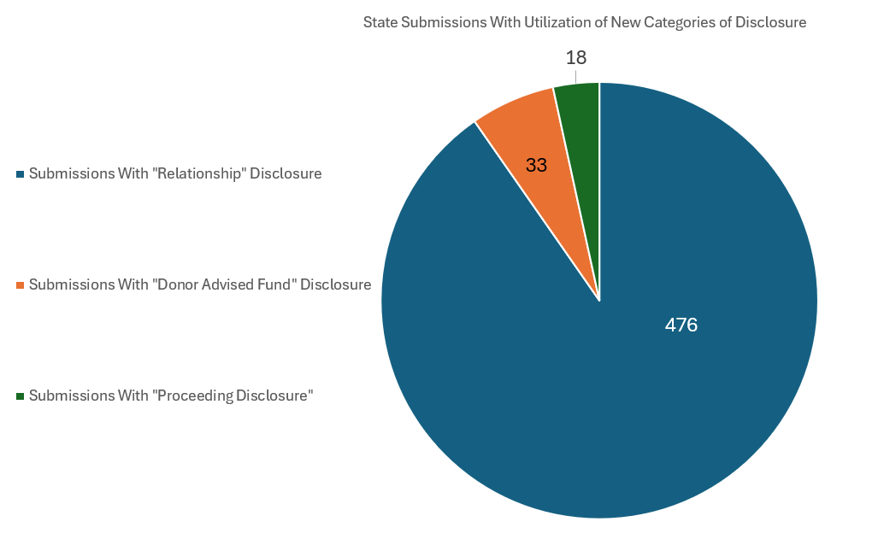

Slide 13
Finding #3:
Of the state and local submissions that included information pursuant to one or more of the new disclosure categories reviewed, roughly 24% of those filings appear to have at least one error reported, such as utilizing an incorrect field or not filling out all the relevant new fields. This may indicate that additional efforts are needed to educate filers on when the new categories apply.

Slide 14
Thank you!

