Slide 1
  Patrick Ford
  Senior Policy & Legislative Affairs Counsel
  San Francisco Ethics Commission
Behested Payments: The San Francisco Experience
FPPC Law and Policy Committee
September 9, 2020
Notes:
15 seconds

Slide 2
The views contained in this presentation are those of the speaker and do not necessarily reflect the views of the San Francisco Ethics Commission or its staff.
Notes:
15 seconds

Slide 3
Behested Payments
Ethical Concerns
San Francisco Regulation
Takeaways
Notes:
15 seconds

Slide 4







Behested Payments – Ethical Concerns
Behested Payment: a payment by one person to another, made at the behest of an official
  “At the behest of”: under the control or at the direction of, in cooperation, consultation, coordination, or concert with, at the request or suggestion of, or with the express, prior consent of (CA Gov. Code § 82041.3)
Official
Payor
Payee (Charity)
Notes:
faster

Slide 5


Behested Payments – Ethical Concerns
Problematic Ask
Payor has matter before Official
Official “uses office”
Benefits
Income
Control
Family Income or Control
Voting Director
Free Services
Nonvoting/Honorary Director
?
Official
Payor
Payee (Charity)

Slide 6
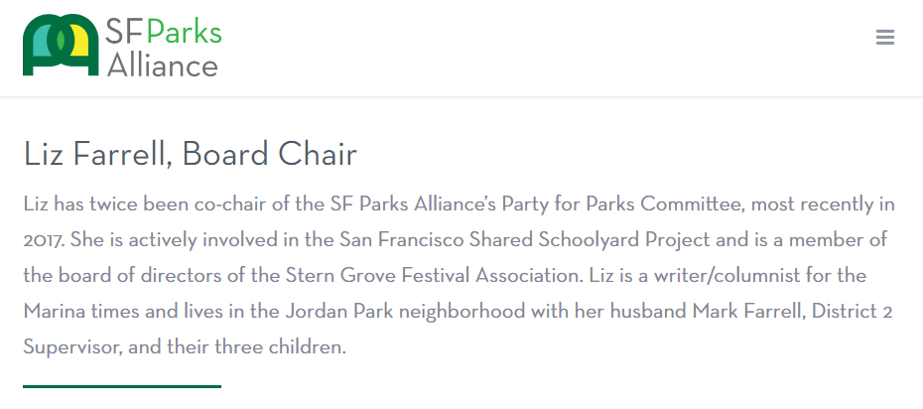

Behested Payments – Ethical Concerns
ISP Ordinance
From 2015 to 2017, Farrell behests $747,500 to Parks Alliance.
City contractors
Companies supporting/opposing legislation
10/15/2017
10/18/2017
11/14 – 11/30/2017
11/30/2017
AT&T makes $15,000 behested payment to nonprofit
First lobbyist contact
Farrell introduced ordinance
Three more lobbyist contacts
Final lobbyist contact
Ordinance approved by committee

Slide 7
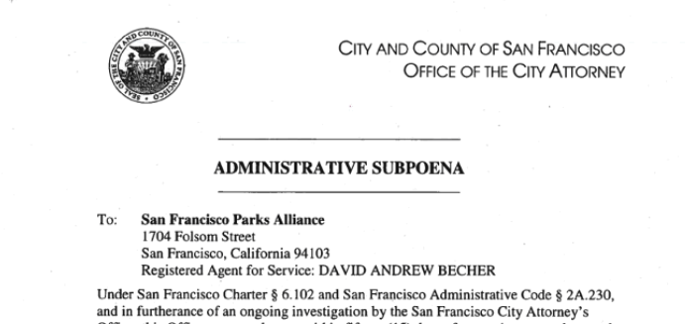
Behested Payments – Ethical Concerns
Problematic Ask
AT&T has ordinance before Official
Benefits
Official’s wife is chair of nonprofit’s board
Nonprofit pays for advertising featuring the official
Official
?
Payor
Payee (Charity)
Notes:
Change this to be Farrell specific

Slide 8
Behested Payments – Local Regulation
COI Rules
Prohibit officials from requesting behested payments from people who have business before the official
  This rule failed to pass in SF in 2018
  Additional disclosure was created in its place (see next slide)
Prohibit officials from using their public office to request behested payments to organizations with which they are affiliated
  This rule was enacted in SF in 2018
  (SF Campaign & Gov. Conduct Code sec. 3.207(a)(1))

Slide 9
Behested Payments – Local Regulation
Additional Disclosure: San Francisco created an expanded disclosure regime to highlight behested payments made by payors with business before the behesting official (based on CA Gov. Code sec. 84308)
Officer
Officers (elected or appointed) must disclose all payments of $1,000 or more
Payor
If one person pays $10,000 or more at the behest of one official, must disclose:
Recipient
Organizations that receive $100,000 or more in behested payments must disclose how they spent the money
whether recipient pays for publicity for officer
whether officer, family, or staff are directors or employees of the recipient, and
the outcome sought, and
the matter that is before the official,
any advocacy contacts made
For each payment, disclose:

Slide 10
Behested Payments – Challenges
COI Rule: Officials cannot use public office to direct anything of value to associated groups
Disclosure: behested payments by “interested persons,” nature of the relationship, how funds used
What does it mean to “use public position or office”
  During official business (lobbyist meeting?)
  Use of letterhead? Title?
What does it mean for an official to be “associated” with a group
  Honorary committee?
Enforcement
How do payor and recipient know that disclosure may be required?
Low volume of disclosure
Enforcement

Slide 11
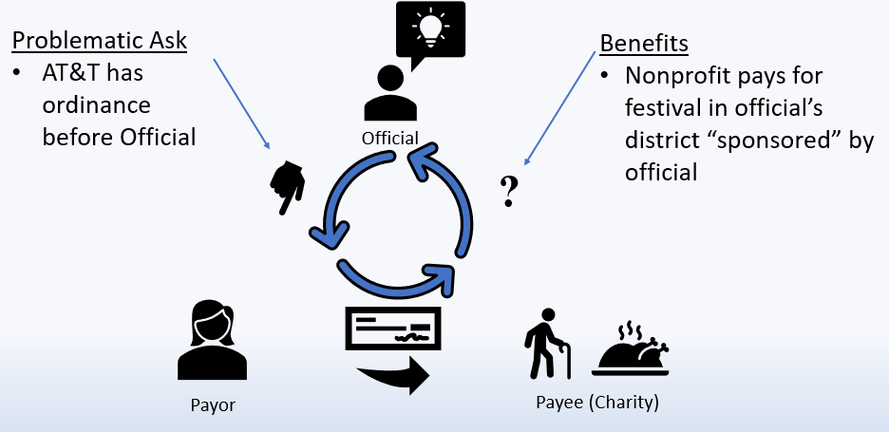
Behested Payments – Key Takeaways
BPs are the third leg of the stool (with contributions and gifts)
Target ethics issues with Conflict-of-Interest Rules, not Disclosure
Target problematic requests and recipients separately (don’t address both in one rule)
  Problematic request – donor has matter before the official (e.g. sec. 84308)
  Problematic recipient – the recipient returns some value to the official

Slide 12
Behested Payments – Key Takeaways
Reform of the Form 803 program is needed
  Allow local jurisdictions to require e-filing
  Allow local jurisdictions to establish a single filing officer (no two-step filing)
  Define an e-filing format (like CAL Format)

Slide 13
Thank You
  Patrick Ford
  Senior Policy & Legislative Affairs Counsel
  San Francisco Ethics Commission
  patrick.ford@sfgov.org

